Slide 1

Privacy Preserving Using Differential Privacy

Slide 2
Contents
Objective
Introduction
Literature survey
Methodology/Block Diagram
Tools to be used
Work Plan
Result
Works to be Completed
Inference / Conclusion
References

Slide 3
Objective
The objective of privacy-preserving techniques in machine learning is to enable the development and deployment of machine learning models while safeguarding the privacy of sensitive data and ensuring compliance with privacy regulations.
This is particularly important in scenarios where the data used for training and inference may contain personal or sensitive information about individuals.
Notes:
e

Slide 4
Introduction
In the big data era, data privacy has become one of the most significant issues. Thus far, there exist plenty of security strategies and encryption algorithms which try to ensure that sensitive data would not be compromised. In addition, among them, most of the security strategies assume that only those who have secret keys can access the confidential data.
However, with the wide use of machine learning, especially the centralized machine learning, in order to train a useful model, data should be collected and transferred to a central point. Therefore, for those private and sensitive data, it will inevitably face the risk of data leakage. Thus, how to do machine learning on private datasets without data leakage is a key issue for sharing intelligence.
Differential privacy is designed to protect the privacy of data when performing statistical queries or data analysis. It's suitable for scenarios where you want to release aggregate statistics about a dataset while preserving individual privacy.

Slide 5
Introduction
Basically, the model is trained jointly by gradient learning under the protection of multi-party privacy. In detail, the model is optimized by gradient descent in each iteration, and one could learn from other users’ data by transmitting the gradient.
However, according to member inference attack mentioned in, malicious users in the training might use the plaintext gradient to train a shadow model to compromise the data security of other users.
Thus, we introduce homomorphic encryption against this attack, which allows one to perform calculations on encrypted data without decrypting it. In addition, the result of the homomorphic operation after decryption is equivalent to the operation on the plaintext data.
Since the operation is not able to identify the data being operated in the whole process of homomorphic operation, the security of privacy data can be guaranteed.

Slide 6
Literature survey
Sl.No | Authors | Title of the paper | Journal | Year
1 | Haokun Fang and Quan Qian | Privacy Preserving Machine Learning with Homomorphic Encryption and Federated Learning | MDPI | 2021
2 | Georgios A. Kaissis, Marcus R. Makowski, Daniel Rückert & Rickmer F. Braren | Secure, privacy-preserving and federated machine learning in medical imaging | IEEE | 2020
3 | Reza Shokri, Vitaly Shmatikov | Privacy-Preserving Deep Learning | ACM Digital Library | 2015

Slide 7
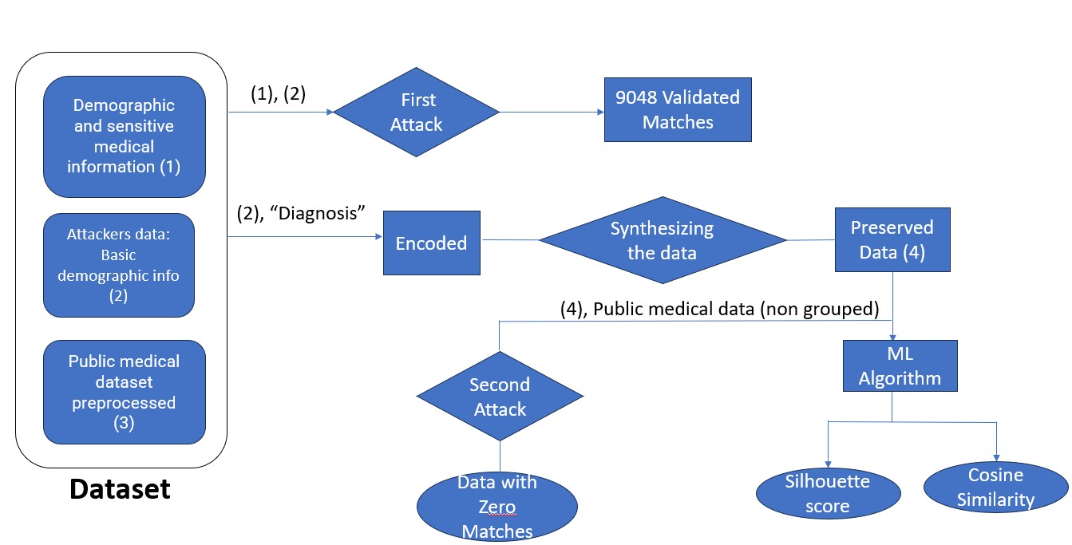
Methodology/Block diagram

Slide 8
Data Used for preserving privacy
Synthesized Data for Privacy Preservation:
Synthesized data is a privacy preservation technique that involves generating artificial data that closely resembles the original data while protecting the privacy of individuals. It is particularly useful for datasets containing sensitive or personal information, such as demographic data. Here's how synthesized data can be applied to demographic and public datasets.
Demographic Data:
Generating Synthetic Demographic Data: In the case of demographic data, synthesized data can be created by using statistical models and techniques to mimic the statistical characteristics of the original dataset, such as age distributions, gender ratios, income ranges, and more.
Preserving Privacy: Synthetic data is designed in such a way that it doesn't correspond to real individuals in the dataset. It's important to ensure that any generated data cannot be linked back to specific individuals, thus preserving their privacy.
Applications: Synthetic demographic data can be used for research, analysis, or sharing with third parties without revealing sensitive information about individuals. It enables the release of data for public use while minimizing the risk of re-identification

Slide 9
Public Data:
Creating Synthetic Public Data: Public data, like government statistics or open datasets, can also benefit from synthesized data. In this context, synthetic data is generated to provide an alternative version of the public data while still capturing its essential statistical properties.
Enhancing Data Utility: Synthetic public data can be used to overcome limitations in the quality or granularity of real public data. It can fill in gaps, extend historical records, or simulate data for regions or time periods where real data may be scarce.
Privacy Assurance: By releasing synthetic data derived from public sources, the risk of revealing individual information or violating privacy is reduced. The public can access valuable information without compromising privacy.

Slide 10
Multiple Weight Mechanism
Differential privacy is a framework for privacy-preserving data analysis that aims to protect individuals' data while still allowing meaningful statistical analysis. It involves adding controlled noise to the query results to prevent re-identification of individual records in the dataset. "multiple weights" or differential privacy with varying sensitivities can be applied:
Sensitivity and Differential Privacy:
Varying Sensitivities:
Weighted Differential Privacy:
Privacy Guarantees:
Noise Addition:
Balancing Privacy and Utility:

Slide 11
Re-identification Attack
A re-identification attack, often referred to as a re-identification risk or re-identification threat, is a privacy breach in which an individual's supposedly anonymized or de-identified data is used to identify or re-identify them. This occurs when an attacker, through various means, is able to link an anonymized dataset to an individual, thereby revealing the person's identity or sensitive information.Re-identification attacks can compromise privacy and confidentiality, especially in contexts where organizations or researchers collect and release data for analysis, but they want to protect the identities of individuals in the dataset.
Healthcare Data: When medical records or health-related data are shared for research purposes, identifying individuals from the data can lead to privacy breaches.
Location Data: Anonymized location data from mobile devices can be reidentified to track a person's movements and habits.
Social Media Data: Information shared on social media platforms, even if anonymized, can sometimes be used to identify users.
Census Data: Census data, which is collected to provide aggregated statistics, can be reidentified to reveal individual-level information.
Financial Data: Financial transactions and credit card data, even with identifiers removed, can be susceptible to re-identification.

Slide 12
Tools to be used for implementing the project
MWEMSynthesizer
Differential privacy is a framework for privacy-preserving data analysis that aims to protect individuals' data while still allowing meaningful statistical analysis. It involves adding controlled noise to the query results to prevent re-identification of individual records in the dataset. "multiple weights" or differential privacy with varying sensitivities
diffprivlib (Differential Privacy Library):
diffprivlib is a Python library that focuses on differential privacy techniques for machine learning. It provides tools and algorithms to incorporate differential privacy into your machine learning workflows.

Slide 13
Work plan
Week Tasks | Week1 | Week2 | Week3
Dataset |  |  |  |  |  | Completed
First Attack |  |  |  |  |  | Completed
New Synthezied data |  |  |  |  |  | Completed
Validate new synthesized data |  |  |  |  |  | Completed
Second Attack |  |  |  |  |  | Completed

Slide 14


Results
For Synthesized Data:
For Original Data:
Cosine Similarity:

Slide 15
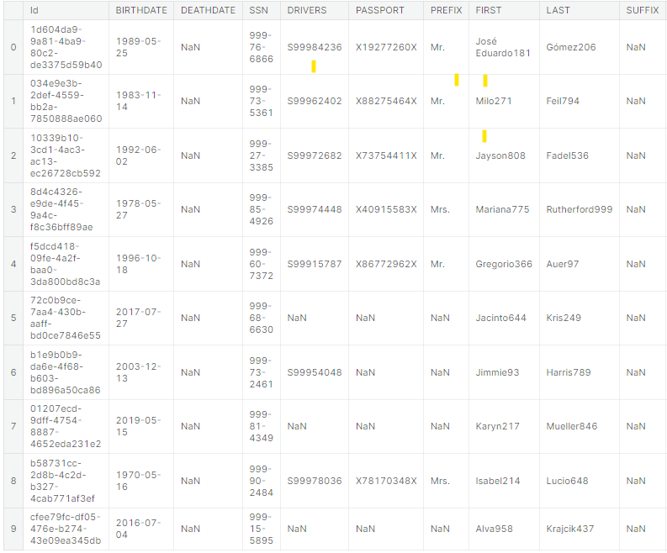
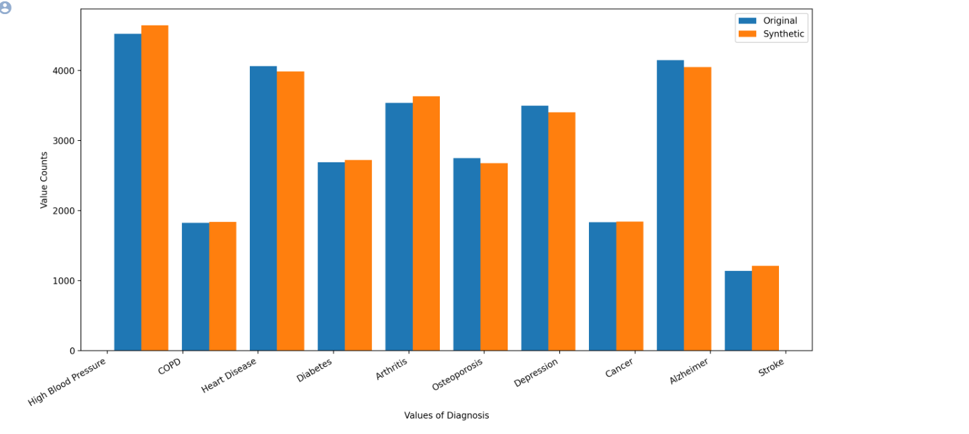
Results

Slide 16

Results

Slide 17
Inference or Conclusion
Synthesized the demographic data
Compared original and synthetic data
Performed Reidentification Attack - Synthesized Demographic Data + Public Medical Data in non-grouped manner
we perform the reidentification attack with the synthetic data, again using a combinatorial approach.
we show the amount of potential and actual matches and provide a glance at the data.

Slide 18
References
Ali Shafahi, W Ronny Huang, Mahyar Najibi, Octavian Suciu, Christoph Studer, Tudor Dumitras, and Tom Goldstein. Poison frogs! targeted clean-label poisoning attacks on neural networks. In Advances in Neural Information Processing Systems, pages 6103–6113, 2018.
Tianyu Gu, Brendan Dolan-Gavitt, and Siddharth Garg. Badnets: Identifying vulnerabilities in the machine learning model supply chain. arXiv preprint arXiv:1708.06733, 2017.
Eugene Bagdasaryan, Andreas Veit, Yiqing Hua, Deborah Estrin, and Vitaly Shmatikov. How to backdoor federated learning. arXiv preprint arXiv:1807.00459, 2018.
Tom B Brown, Benjamin Mann, Nick Ryder, Melanie Subbiah, Jared Kaplan, Prafulla Dhariwal, Arvind Neelakantan, Pranav Shyam, Girish Sastry, Amanda Askell, et al. Language models are few-shot learners. arXiv preprint arXiv:2005.14165, 2020.
Lei Yu, Ling Liu, Calton Pu, Mehmet Emre Gursoy, and Stacey Truex. Differentially private model publishing for deep learning. In 2019 IEEE Symposium on Security and Privacy (SP), pages 332–349. IEEE, 2019.
Rachel Cummings, Varun Gupta, Dhamma Kimpara, and Jamie Morgenstern. On the compatibility of privacy and fairness. In Adjunct Publication of the 27th Conference on User Modeling, Adaptation and Personalization, pages 309–315, 2019.
Mohammad Naseri, Jamie Hayes, and Emiliano De Cristofaro. Toward robustness and privacy in federated learning: Experimenting with local and central differential privacy. arXiv preprint arXiv:2009.03561, 2020.

